Slide 1
BIHAR YATRA SETU AAIYE NA BIHAR ME…….
Discover Bihar's hidden gems with Bihar Yatra Setu, your ultimate digital companion….

Slide 2
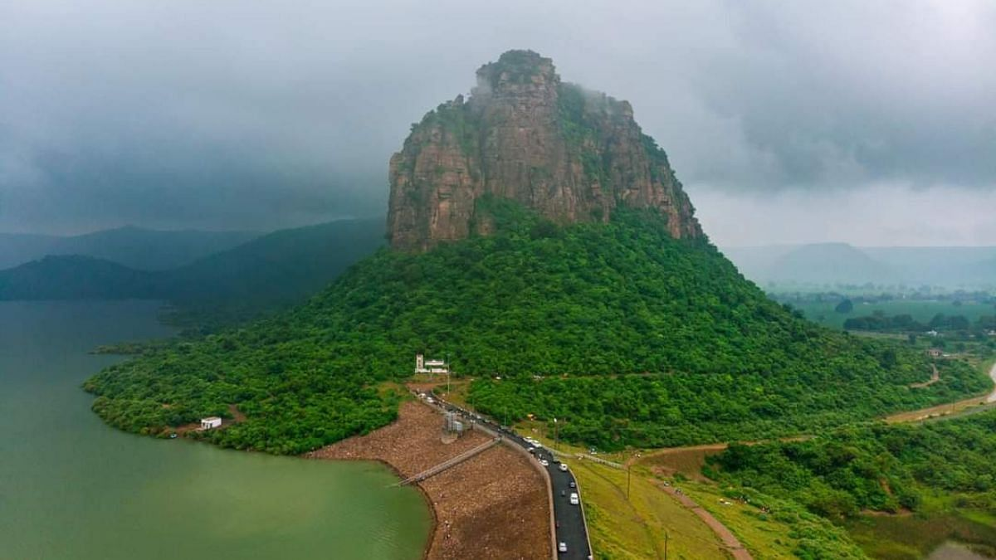
Bridging the Tourism Gap
Bihar's rich heritage is vast yet underexplored by modern tourism. Travellers often face challenges finding reliable guides, transport, and authentic local experiences. Bihar Yatra Setu revolutionises this by offering a comprehensive digital platform.

Slide 3
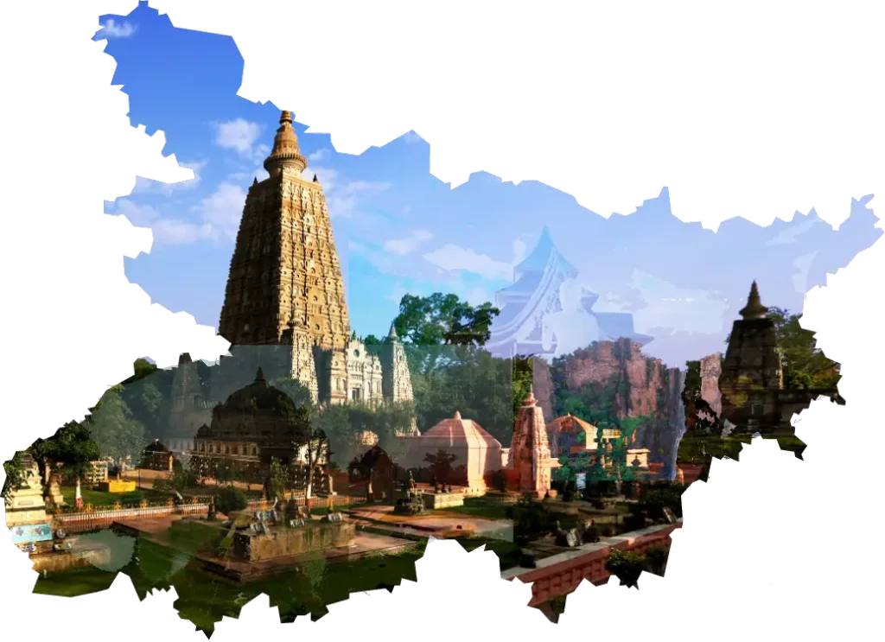
THE CORE CHALLENGES
No Integrated App
Bihar lacks a unified, user-friendly tourism application.
Limited AR Content
Historic sites miss out on interactive, AR-based information.
Missed Experiences
Tourists often overlook authentic local culture and hidden gems.
Booking Difficulties
Finding verified guides and reliable transport is a significant hurdle.

Slide 4

Our Innovative Solution
Map-Based Discovery
Effortlessly locate and explore points of interest on an interactive map
AR Heritage Overlays
Experience historical sites with immersive augmented reality information.
Seamless Booking
Book verified guides and comfortable transport directly through the app.
Local Immersion
Curated Tours
Access diverse tour packages and highlights of local festivals.
1
2
3
4
Discover authentic art, cuisine, and unique local accommodation options
5

Slide 5
KEY FEATURES
Map Discovery
Interactive maps for seamless site exploration.
AR Info
Augmented reality for rich monument details.
Booking Services
Easy reservations for guides and transport.
Stay Listings
Curated list of local accommodations.
Tour Packages
Pre-designed tours for diverse interests.
Reviews & Alerts
User reviews and real-time travel alerts.

Slide 6

TECH STACK
✅ Frontend:
HTML5 — for structuring web pages
CSS3 — for styling pages (can use Bootstrap for responsiveness)
JavaScript (optional) — for interactivity (sliders, dropdowns, forms)
✅Backend:
Python Flask (lightweight web framework for routing and serving pages)
✅Database:
MySQL — for storing users, bookings, guide details, transport listings, reviews, etc.
Connect Python to MySQL via mysql-connector-python
✅ Hosting:
Localhost (XAMPP/WAMP) for dev

Slide 7

TEAM NAME : CODE CRAFTERS
TEAM MEMBERS:
1.) PRATHAM KISHOR
(FRONTEND AND BACKEND)
2.)GAURAV SINGH RAJPUT
(DATABASE AND BACKEND)

Slide 8
THANK YOU!

